Slide 1
pcn
Comprehensively manage the PovcalNet files and folders

Slide 2
pcn
create
load
groupdata
download
master

Slide 3
pcn
create
load
groupdata
download
master
pcn subcommand , countries(3-letter code) year(####) options

Slide 4
pcn
create
Load
groupdata
Download
Master
Loads into memory the file corresponding to the parameters given by the user.
GPWG
Working Data (WRK)
Estimates
pcn load [kind] , countries(3-letter code) year(####) options

Slide 5
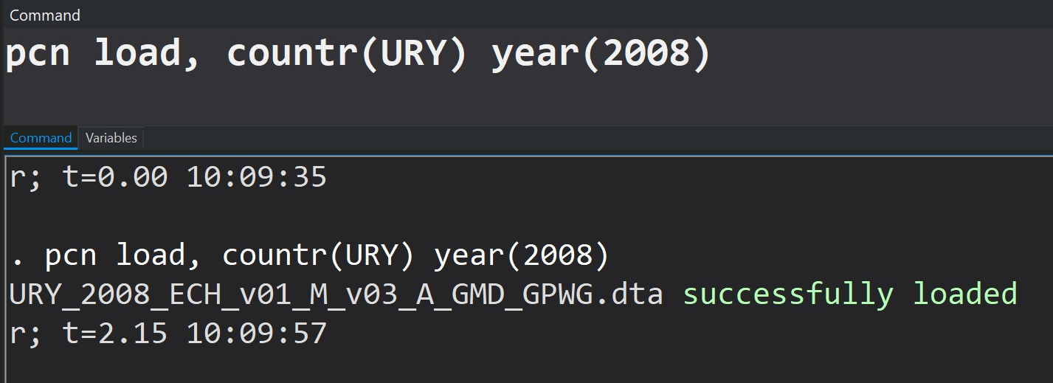
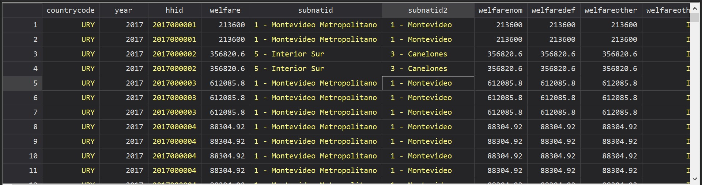
GPWG (default)
Working (WRK)
Estimates
CPI
pcn
create
Load
groupdata
Download
Master
Loads: GPWG 2008 Uruguay Data

Slide 6
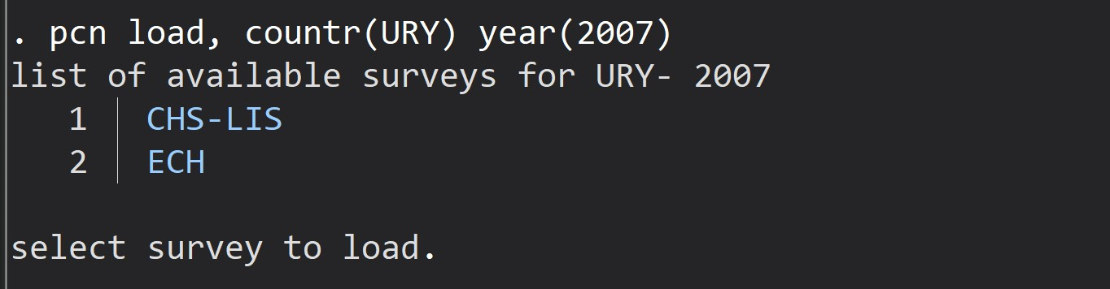
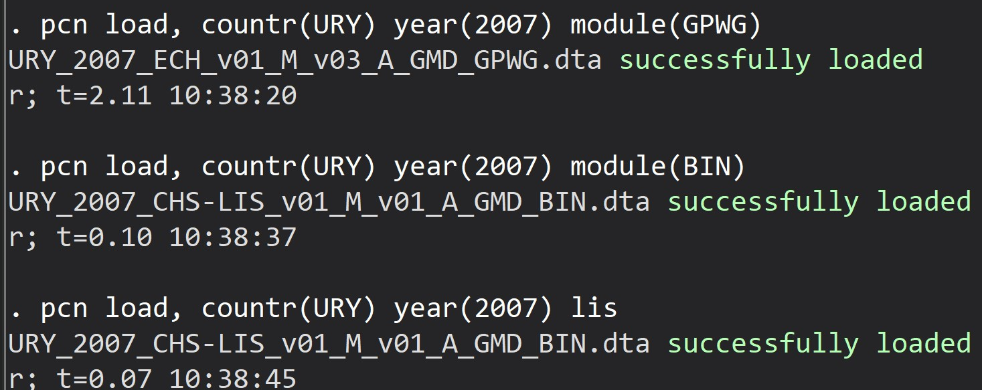
If more than one a list deploys
GPWG (default)
Working (WRK)
Estimates
CPI
pcn
create
Load
groupdata
Download
Master
Avoid the list:
Module / lis options

Slide 7
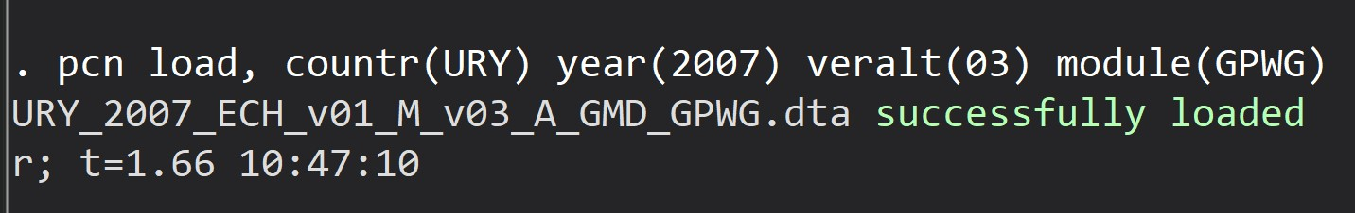
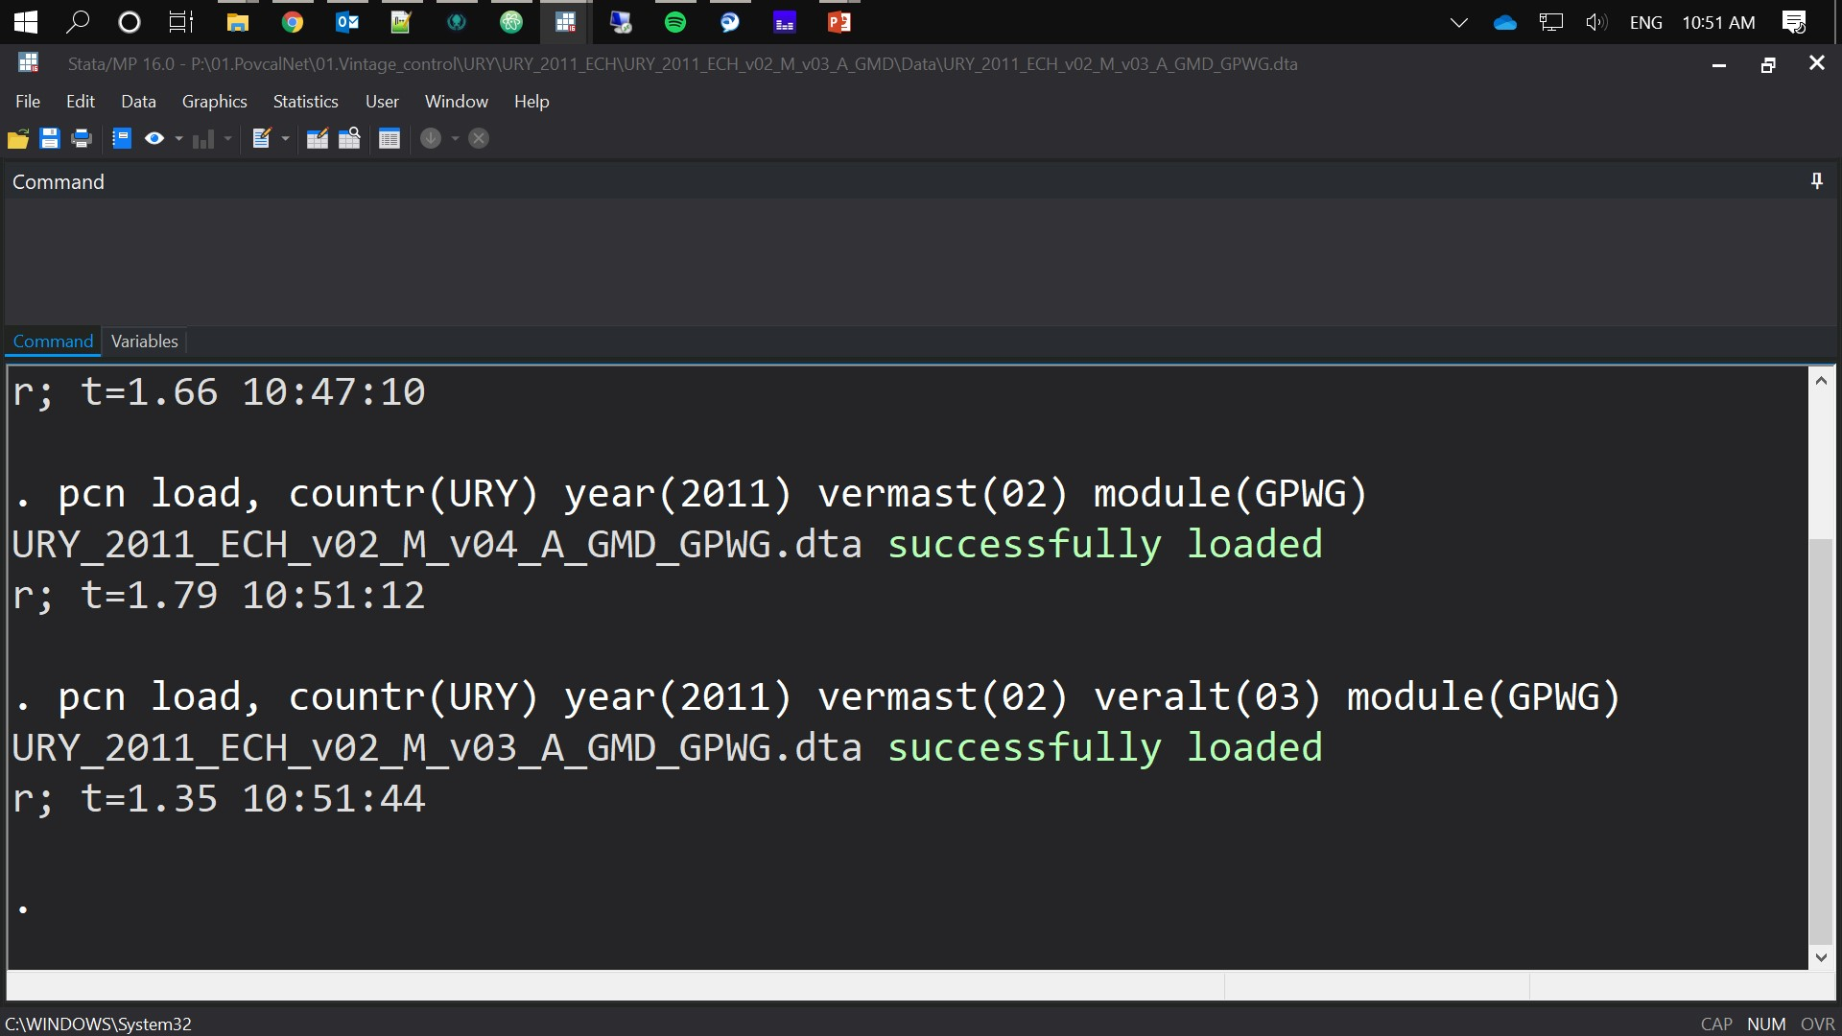
Replications Exercises:
GPWG (default)
Working (WRK)
Estimates
CPI
Choosing an alternative version:
veralt(##) option
pcn
create
Load
groupdata
Download
Master
Choosing an alternative version:
vermast(##) option
vermast and veralt can be combined

Slide 8
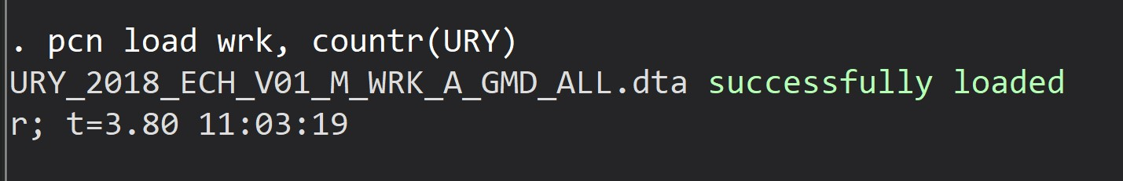
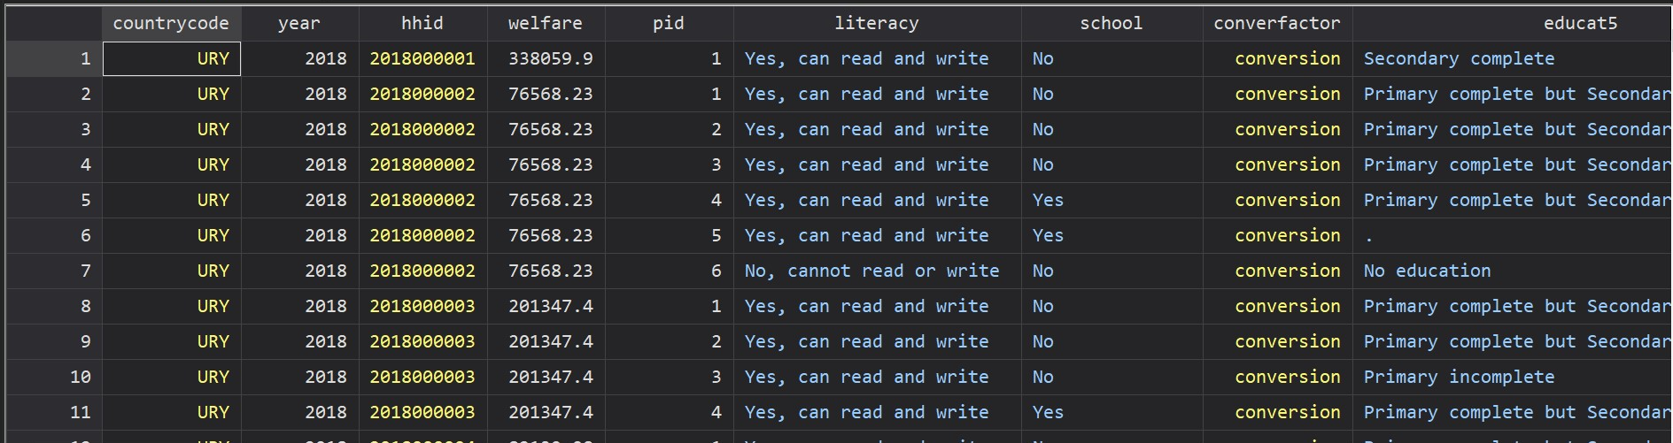
GPWG (default)
Working (WRK)
Estimates
CPI
pcn
create
Load
groupdata
Download
Master
Loads: Working data for the latest year

Slide 9
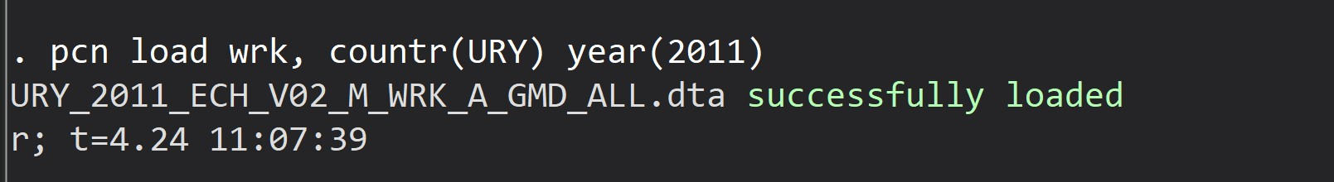
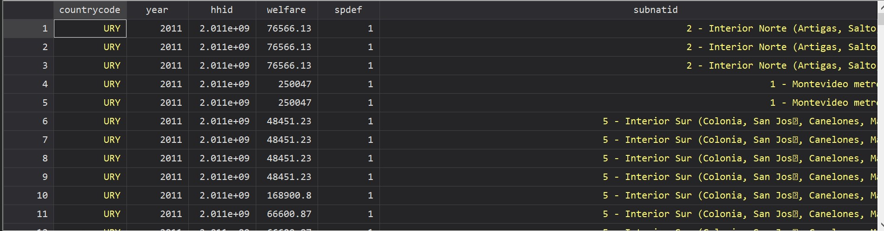
GPWG (default)
Working (WRK)
Estimates
CPI
pcn
create
Load
groupdata
Download
Master
Loads: Working data for the given year

Slide 10
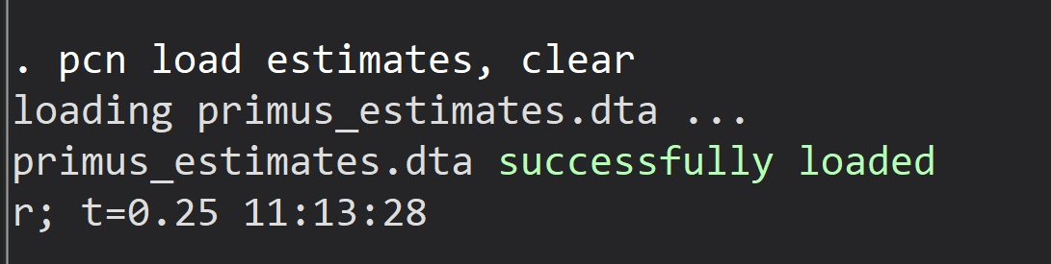
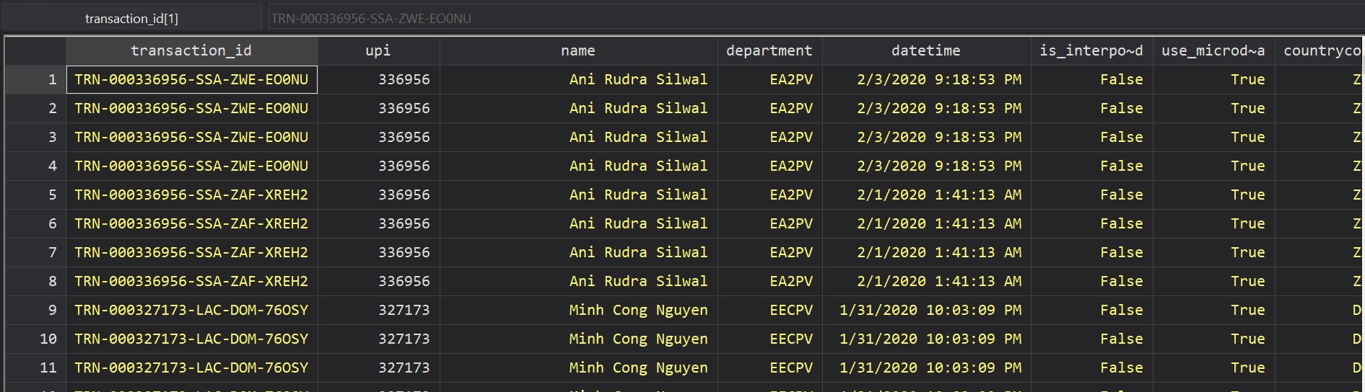
GPWG (default)
Working (WRK)
Estimates
CPI
pcn
create
Load
groupdata
Download
Master
Loads: Primus estimates output

Slide 11
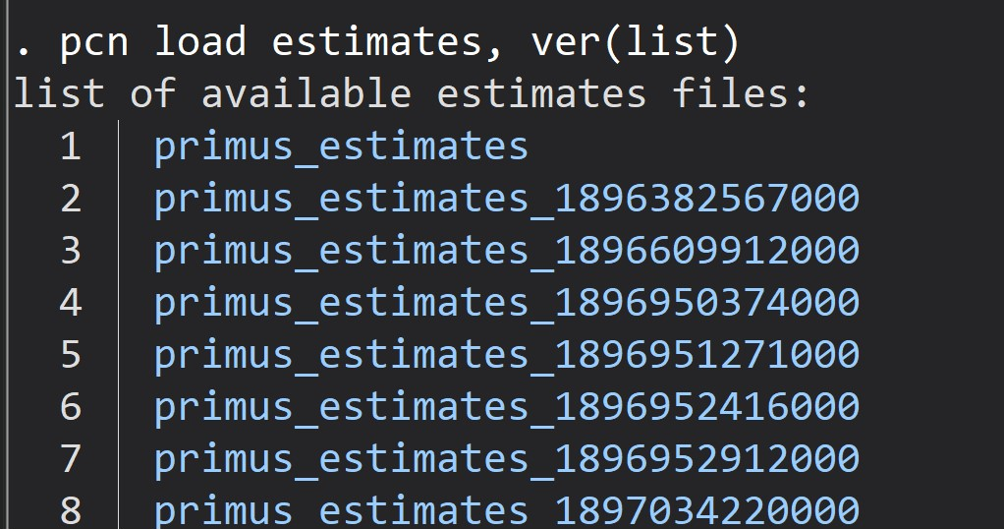
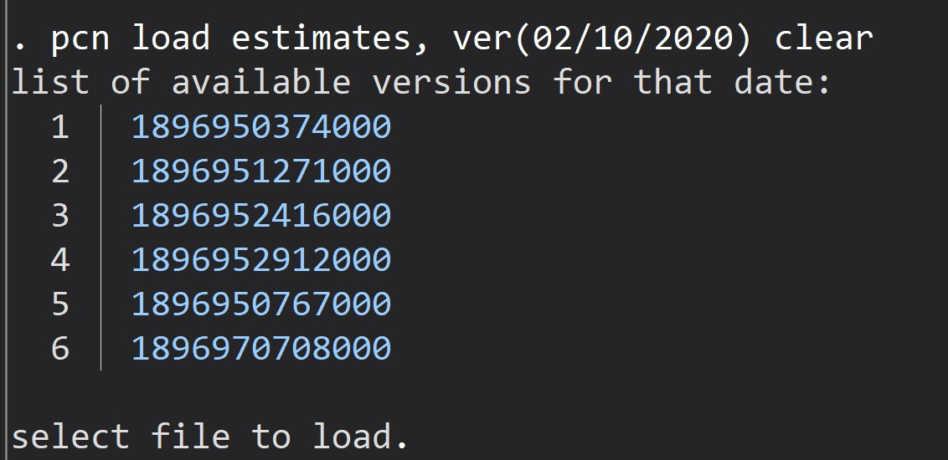
Version option
GPWG (default)
Working (WRK)
Estimates
CPI
pcn
create
Load
groupdata
Download
Master

Slide 12

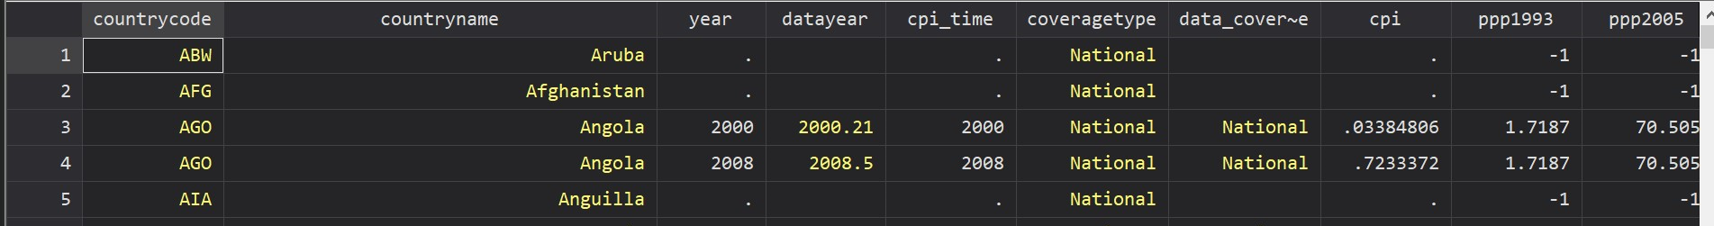
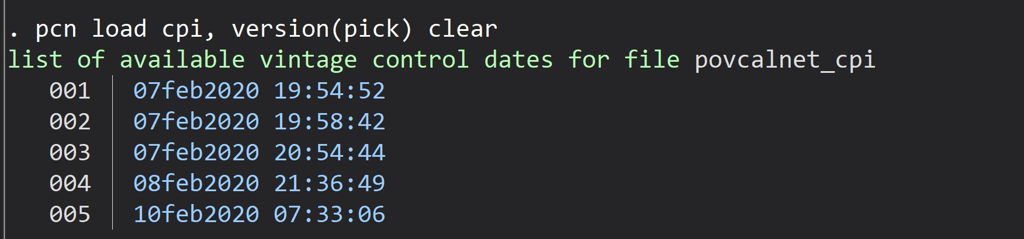
GPWG (default)
Working (WRK)
Estimates
CPI
pcn
create
Load
groupdata
Download
Master
Loads: CPI data
Version option:

Slide 13
pcn
create
Load
groupdata
Download
Master
Loads or updates the master file.
pcn master , load(sheet) shape(long) version(pick\choose\select) options

Slide 14
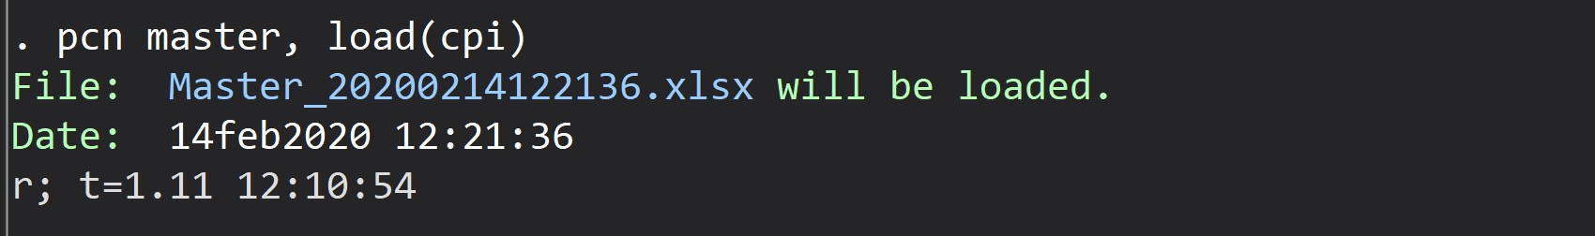
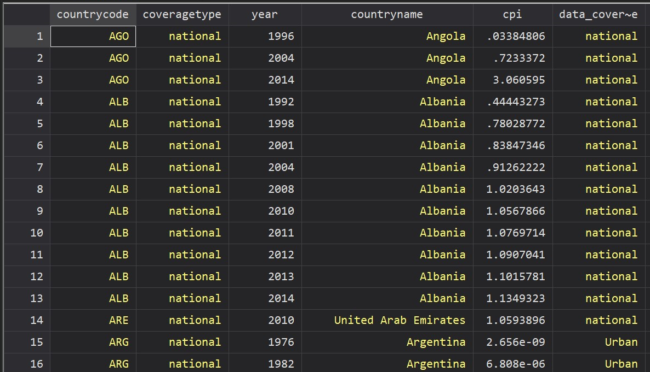
Update
Load
pcn
create
Load
groupdata
Download
Master
Loads: CPI data from the master

Slide 15
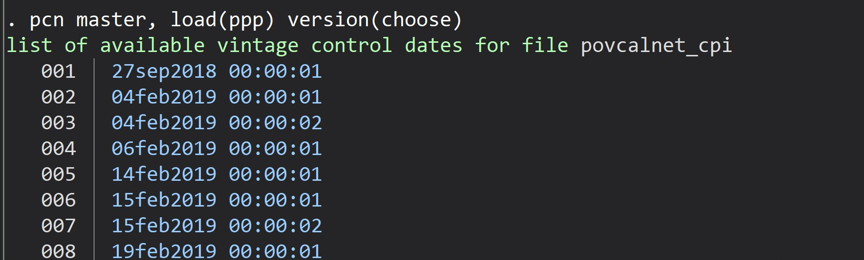
Update
Load
pcn
create
Load
groupdata
Download
Master
List the vintages to pick and load

Slide 16
pcn
create
Load
groupdata
Download
Master
This subcommand check for existing group data information and updates (or generates) the information.
pcn gd , options
pcn group , options
pcn groupdata , options

Slide 17

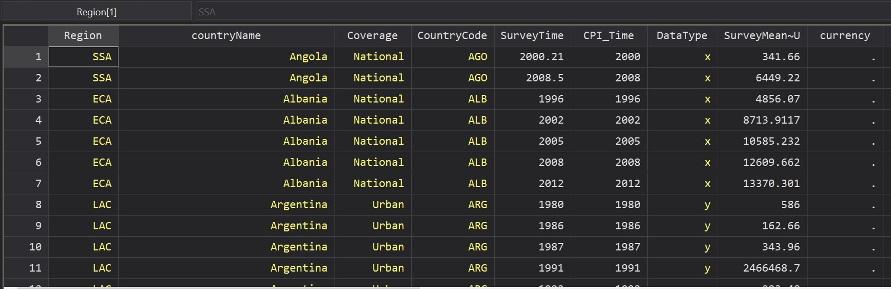
pcn
create
Load
groupdata
Download
Master
Check, upload and loads Group Data

Slide 18
pcn
create
Load
groupdata
Download
Master
Creates a dataset containing weights and welfare. (Relevant for PovcalNet tools.)
pcn create , , countries(3-letter code) year(####) options

Slide 19

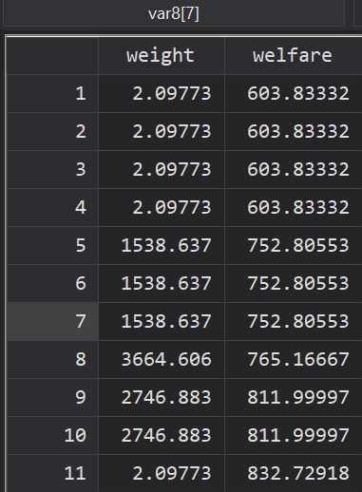
pcn
create
Load
groupdata
Download
Master
Creates txt file with weight and welfare for Denmark 2013 (also loads it)

Slide 20
pcn
create
Load
groupdata
Download
Master
(Rarely used). Downloads the latest file(s) available. Should be only used when major updates are released.
GPWG
Pending
Working
pcn download [kind] , countries(3-letter code) year(####) options

